Slide 1

BLOG TIPS
Maximizing engagement and metrics
Taking your blog to the next level – increase traction and engagement with tagging, categories, sharing and multimedia

Slide 2
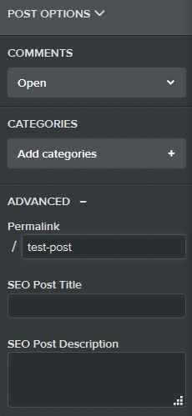



Topic #1: Improving SEO on individual posts
SEO parameters
SEO post title:
50-60 characters
SEO post description: 255 characters max
+

Slide 3

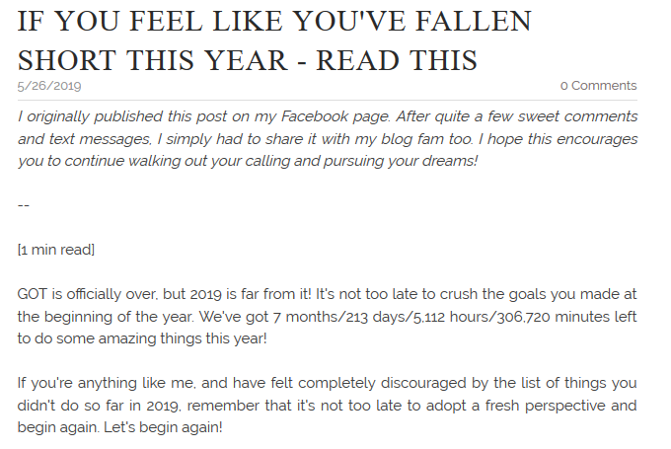
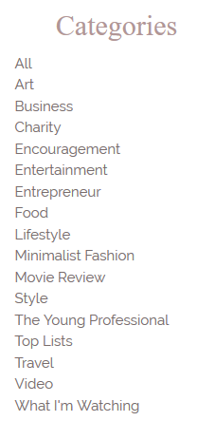
Topic #2: Value of “Categories”
Categories
Categories help bloggers group posts. They serve as a way to parcel out related topics and group them in a logical, hierarchical way.
Source: Stasia Rose blog

Slide 4
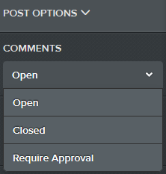
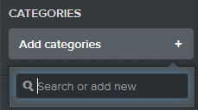
Topic #3: Comments
Manage comments settings – on, off or require approval
Add categories

Slide 5
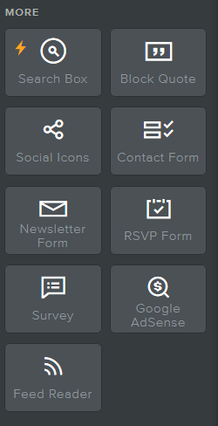
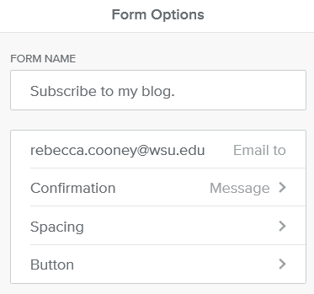
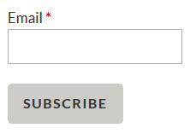
Topic #4: Increase subscribers

Slide 6
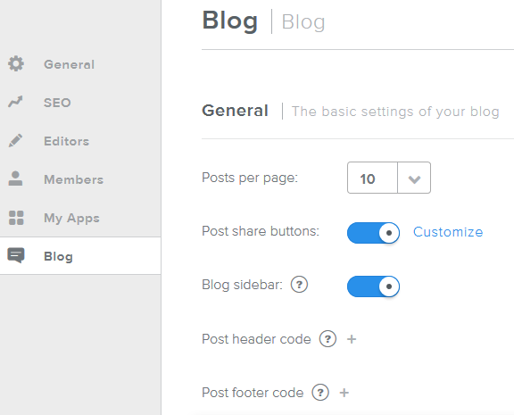
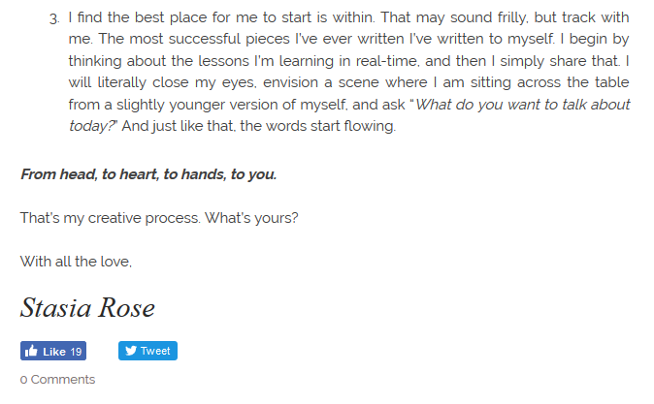
Topic #5: Increasing “shares” of your posts
Source: Stasia Rose blog

Slide 7




Topic #6: Adding more photos & videos
“[multimedia]… bonds writing with images, videos, audio and slideshows in a useful and engaging way.”
“People are far more likely to engage with and share your stories and posts if they contain images, graphics, audio clips or video presentations.”
- Nicoleta Halaciuga
Types of multimedia
  Photos
  Videos
  Slideshows
  Audio
  Infographics
Benefits
Multimedia increases time on site
Multimedia optimizes on-site SEO
(use alt tags with every upload)
Multimedia helps build your personal brand
RESOURCE: At Cincopa.com by Nicoleta Halaciuga. Product Expert

Slide 8
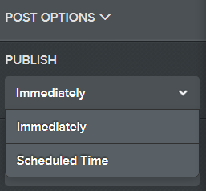
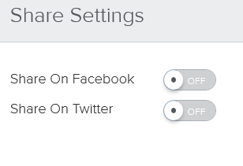
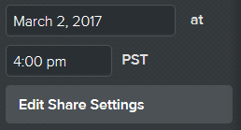
Topic #7: Scheduling blog posts
Post Timing:
Morning is best between 8a-noon (11a is optimum)
The average blog gets the most traffic on Mondays

