Slide 1
WEB DEVELOPMENT
BASICS
Continued lessons in visual design
CHELSEA NEWMAN, MS
Clinical Assistant Professor

Slide 2
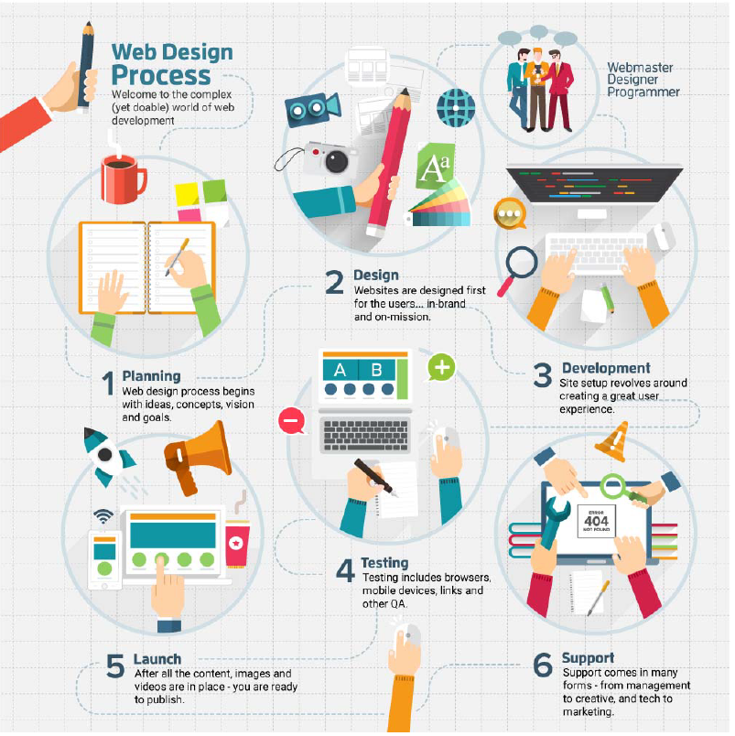

Slide 3
Web Development Strategy
Typical site goals:
  Build awareness
  Sell tickets
  Online orders
  Connection to customers
Get donations
  Get volunteers
  Get participants
  Persuade opinion
  Inform public
What are the goals for your site – what do you hope to accomplish?
What is the central message you want to convey through the site?
What is the “wish list” of content, features, multimedia and engagement tools for your site?

Slide 4
Web Content Strategy
What specific information do you want to offer visitors?
What information already exists and can be incorporated into the site?
What sections and subsections do you know you want to include?
What new content is required and needs to be generated?
What resources, services, etc. will be offered on the site?
How do you want to structure the content? Does a desired user path already exist?
Source: Hub Spot… “Building a Killer Content Strategy”

Slide 5

Create content for your audience - not stakeholders
Use examples and testimonials
Be brief, easy to scan and optimize
Web Content Best Practices
When people come to you online, they are not looking for TV commercials. They are looking for information to help them make a decision.
David Meerman-Scott, sales and marketing strategist and author
Be the expert in your business, products and services
Update content regulary and with intention
Give them a reason to stay (and come back) with exclusives and incentives
Make copy actionable so you can meet conversion goals

Slide 6
Web Jargon
“Above the fold” – content, links, images, video that appear on screen before user has to scroll
Accessibility – “the degree to which a system is of use to as many people as possible”
Alt tags – associates text or title to an image
CMS – Content Management System
Crawl – “Search engines such as Google have a Bot (see also ‘GoogleBot’) which ‘crawls’ web pages, following links and recording content, maintaining a searchable database of the internet.¹⁵”
CSS – Cascading Style Sheets: code behind format and style of a web page
Domain names – a domain name is the url of a web page
eCommerce – process of selling products online
Favicon – small icon that appears next to url in a web browser (often branded logo or icon)
Flash – vector graphics software that is animated and allows for sites to be more interactive with movement
FTP – File Transfer Protocol: “This protocol is for transferring data between computers, so many content management systems include a FTP capability.¹⁵”
HTML – hypertext markup language
Get so many more at TheMaxDP.co.uk

Slide 7
Web Jargon
Infinite scrolling: term for pages with lengthy copy or content that requires the user to scroll for a long time
ISP – Internet Service Provider (i.e. Internet Explorer, Firefox, Chrome)
JavaScript – Scripting language that is embedded into html and allows for dynamic content
Landing page - term for page visitors initially enter a site
Meta Tags – page titles that are not visible – build into the code
Navigation – term associated with global navigation or sub-navigation or set of links at the top, side or footer of a web page
Responsive – webpage that adjusts in dimensions based on the device and screen size
SEO – Search Engine Optimization
URL – Uniform Resource Locator
Vector – graphics or visuals that include geometric shapes
Get so many more at TheMaxDP.co.uk

