Slide 1


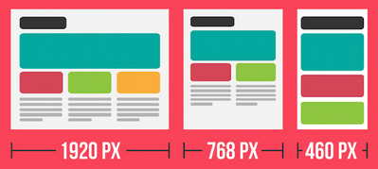
Responsive Web Design
Responsive Design is a web development style where a website automatically detects the screen size or device on which it is being presented and adapts it accordingly.
XHTML Junction
Source: XHTLM Junction
Source: awwwards.com, Julia Blake

