Slide 1
COMPOSITION
& HIERARCHY
Continued lessons in visual design
CHELSEA NEWMAN, MS
Clinical Assistant Professor
(PPT by Rebecca Cooney)

Slide 2

Bad vs. Good Design
Source: General Assembly Visual Communication 101 slide deck, Susannah Hainley, art director and designer

Slide 3

Humans naturally perceive objects as
organized patterns and groups.
-Susannah Hainley, General Assembly

Slide 4

Source: General Assembly Visual Communication 101 slide deck, Susannah Hainley, art director and designer

Slide 5

Source: General Assembly Visual Communication 101 slide deck, Susannah Hainley, art director and designer

Slide 6

Source: General Assembly Visual Communication 101 slide deck, Susannah Hainley, art director and designer

Slide 7
Composition Toolbox

Slide 8

Source: General Assembly Visual Communication 101 slide deck, Susannah Hainley, art director and designer

Slide 9
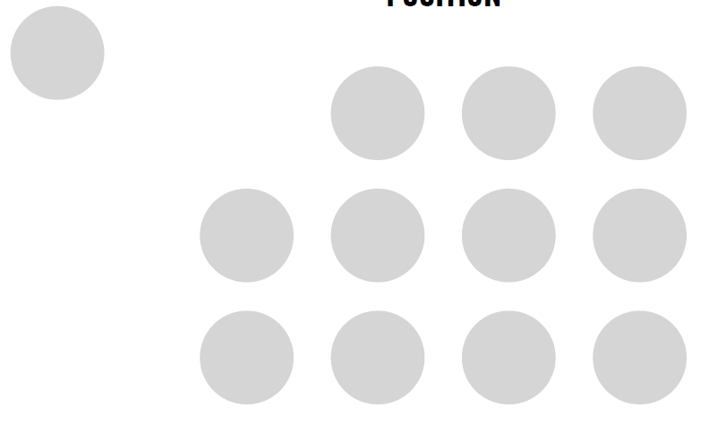
Position
Source: General Assembly Visual Communication 101 slide deck, Susannah Hainley, art director and designer

Slide 10

Source: General Assembly Visual Communication 101 slide deck, Susannah Hainley, art director and designer

Slide 11
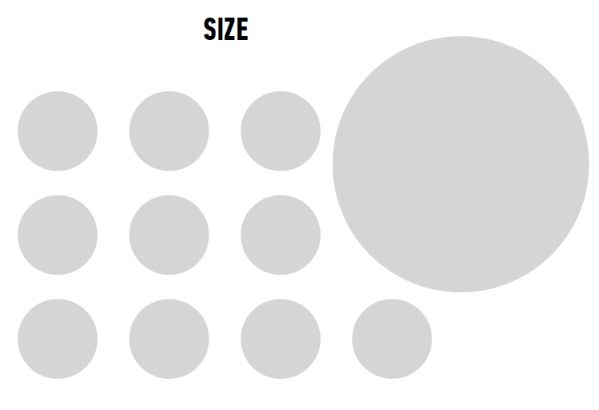
Size
Source: General Assembly Visual Communication 101 slide deck, Susannah Hainley, art director and designer

Slide 12

Source: General Assembly Visual Communication 101 slide deck, Susannah Hainley, art director and designer

Slide 13

Color
Source: General Assembly Visual Communication 101 slide deck, Susannah Hainley, art director and designer

Slide 14

Source: General Assembly Visual Communication 101 slide deck, Susannah Hainley, art director and designer

Slide 15

Proximity
also, white space
Source: General Assembly Visual Communication 101 slide deck, Susannah Hainley, art director and designer

Slide 16

Source: General Assembly Visual Communication 101 slide deck, Susannah Hainley, art director and designer

Slide 17
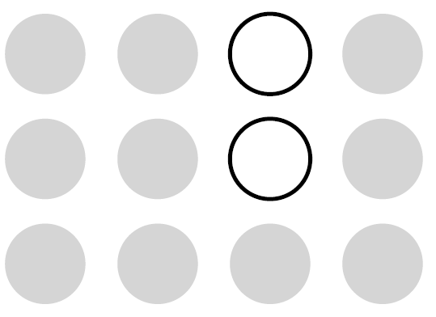
Repetition
Source: General Assembly Visual Communication 101 slide deck, Susannah Hainley, art director and designer

Slide 18

Source: General Assembly Visual Communication 101 slide deck, Susannah Hainley, art director and designer

Slide 19
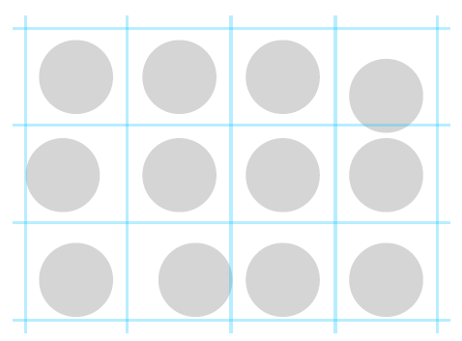
When elements are askew…
Source: General Assembly Visual Communication 101 slide deck, Susannah Hainley, art director and designer

Slide 20
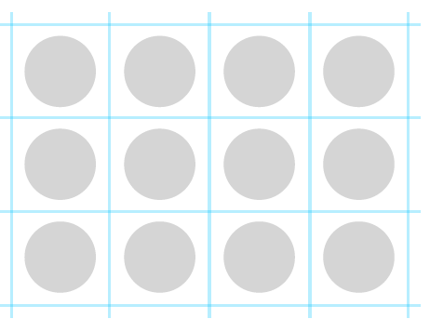
Alignment
Source: General Assembly Visual Communication 101 slide deck, Susannah Hainley, art director and designer

Slide 21

Source: General Assembly Visual Communication 101 slide deck, Susannah Hainley, art director and designer

Slide 22
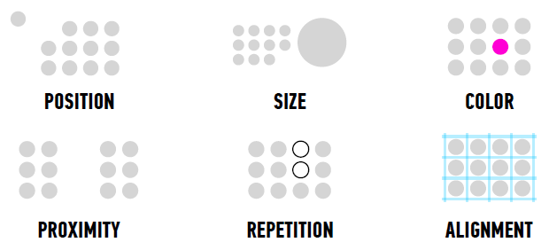
Principles of Composition
Source: General Assembly Visual Communication 101 slide deck, Susannah Hainley, art director and designer

Slide 23

Source: General Assembly Visual Communication 101 slide deck, Susannah Hainley, art director and designer

