Slide 1
FONTS & TYPOGRAPHY
Understanding the psychological and emotional impact of typefaces
CHELSEA NEWMAN, MS
Clinical Assistant Professor
PPT by Rebecca Cooney

Slide 2
“
Each element of the design contributes to user experience, typography is considered to be the core element because users spend more time reading texts than enjoying pictures or doing something else. All parameters applied to the web page typography, no matter what it is: spacing between letters, size, color etc., has a great psychological and emotional impact on viewers.
Alex Bulat, Template Monster

Slide 3
Typography Terminology
Aa | Serif Fonts: Serif fonts have short lines at the top and bottom of each letter. Tend to be more formal in feel. Work best in headings.
Bb | San Serif Fonts: To be sans is to be absent-of the short lines found at the top and bottom of letters. Best for body copy and headlines.
Cc | Script Fonts: Cursive fonts used to elicit elegance and style. Best for headers or accent copy. Should not be used in body copy due to readability.
Dd | Display Fonts: Typically custom creations – best for headlines. Should not be used in body copy (too hard to read when small)

Slide 4
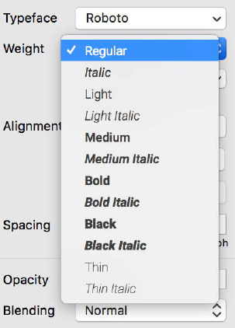
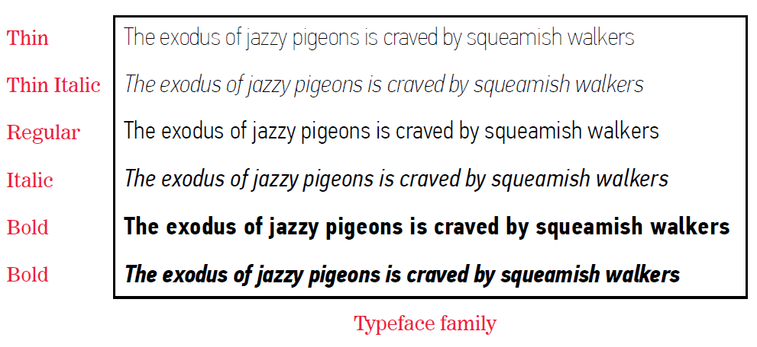
Typeface Family
Source: General Assembly Visual Communication 101 slide deck, Susannah Hainley, art director and designer

Slide 5
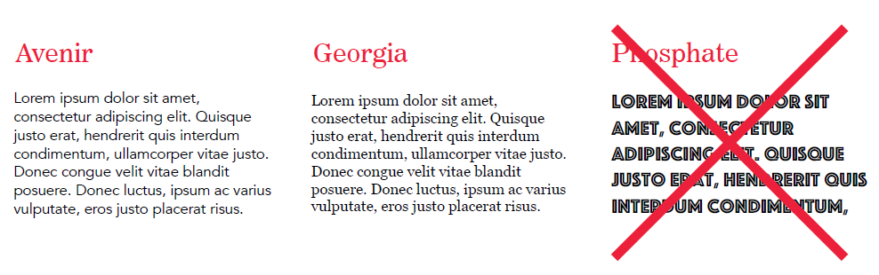
Legibility
“The beauty of type lies in its utility; prettiness without readability serves neither the author nor the reader.”
-James Felici Author,
The Complete Manual of Typography
Source: General Assembly Visual Communication 101 slide deck, Susannah Hainley, art director and designer

Slide 6
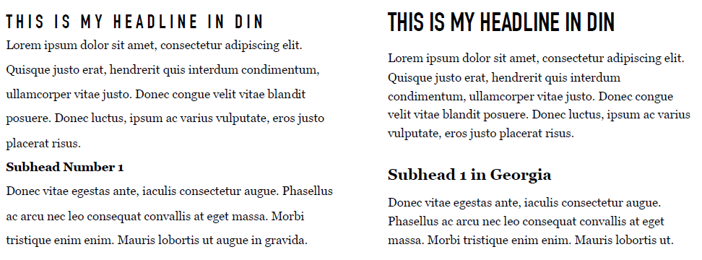
Readability
Source: General Assembly Visual Communication 101 slide deck, Susannah Hainley, art director and designer

Slide 7
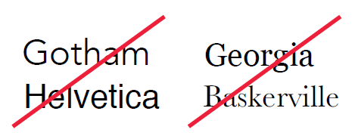
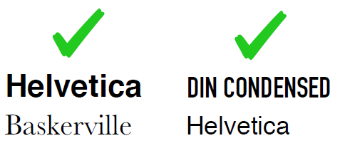
Pairing Typefaces
General Rules
Use 2 (3 max) typefaces
Use a family with multiple weights / styles
Go for contrast: don’t combine typefaces that look very similar
Use bold or italic sparingly
Use centered text sparingly
ALL CAPS are fine for less than one line of text
Never use underlining, unless it’s a hyperlink
Source: General Assembly Visual Communication 101 slide deck, Susannah Hainley, art director and designer

